Slide 1
CSCI 4110 Advanced Behaviours
Mark Green
Faculty of Science
UOIT

Slide 2
Introduction
Examine higher level behaviors and decisions build on the foundation that we already have
Start with walking and navigation, necessary for human animation
End up with crowd animation, dealing with a large number of people

Slide 3
Walking
One of the common motions, for humans and other creatures
A basic component of most animations, so we need to have some way of dealing with it
Walking is a generic term for movement on two or four legs, it includes walking, but also running, skipping, marching, etc.
All are done in a similar way, so we group them together
A large amount of work has been done on walking starting in the 1980s

Slide 4
Walking
One biomechanics researcher stated: “walking is controlled falling”, which is basically true
We walk forward by falling forward and then catching ourselves
This raises the issue of balance, we need to keep our character balanced and at the same time allow them to walk
We don’t want them to fall on their face, but we don’t want the fall forward part of the walking motion prevented

Slide 5
Walking
Class of walking controller based on gait analysis, the style of the motion
Usually examine foot placement during the walk cycle, each gait tends to have a different foot placement
Since the feet are end effectors, we can use their position in inverse kinematics to determine the joint angles required
This can be used to key frame the character or as target angles for a PD controller

Slide 6
Walking
Can have an interactive system for feet placement that can drive the animation
Can even lay out a path based on placement
This produces relatively good motion, easier to design than motion capture, have more control over the motion
Unfortunately, it is not very robust, does not deal with uneven terrain, cannot deal with being hit
It has limited awareness of its environment and can’t respond to it

Slide 7
Walking
There are a number of walking controllers that have been motivated by research in robotics
They have legged creatures that need to move, so it should be possible to use their algorithms
There is a problem here, can design the robot to make locomotion easier, we cannot do this with the human body
While some of the techniques work well for mechanical systems, they don’t work very well for humans and similar characters

Slide 8
SIMBICON
SIMBICON is a state of the art motion controller framework for human locomotion
It can be used for a wide range of motions
Motions can be designed using a interactive editor, or they can be constructed from motion capture data
The framework is based on three components:
Interactive editor for gait and motion design
Balance control system
Feedback error learning

Slide 9

SIMBICON

Slide 10
SIMBICON
Controller design starts with building a finite state machine for the motion, see the next slide
Each state has a pose for the character, the joint angles that we want to achieve
A PD controller is used to drive the dynamics to achieve these joint angles
In many cases the goals aren’t reached before a transition between states occurs
Transitions are triggered by a time period, or an event, such as the foot striking the ground

Slide 11
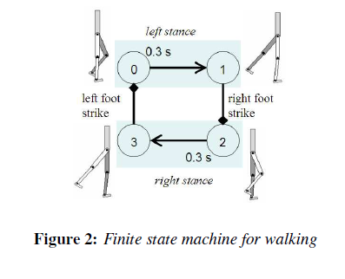
SIMBICON

Slide 12
SIMBICON
Most of the SIMBICON motion controllers have only four states
Can transition between motions, on transition signal move from state n of current controller to state n+1 of next controller
The balance controller is based on the torque about the torso, τ_{torso}, the swing hip torque τ_{B} and the stance hip torque τ_{A}, see the next slide
Both the torso torque and the swing hip torque are computed in the world coordinate system, and their controllers operate in that system

Slide 13
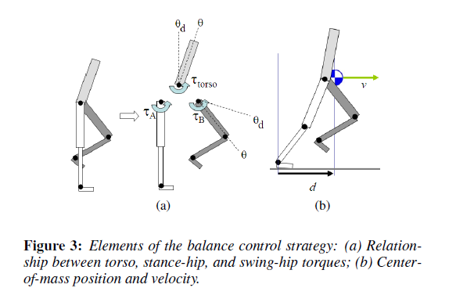
SIMBICON

Slide 14
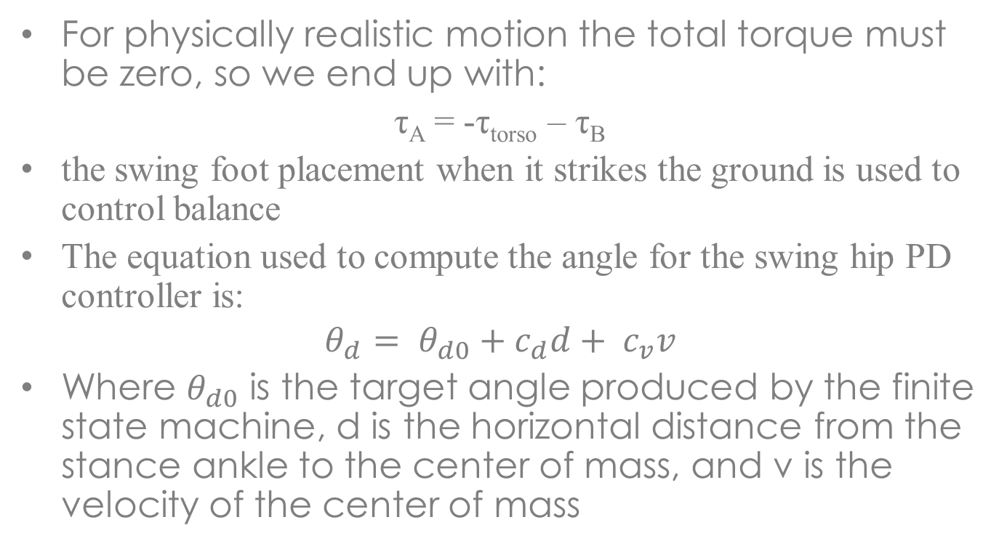
SIMBICON
For physically realistic motion the total torque must be zero, so we end up with:
τ_{A} = -τ_{torso} – τ_{B}
the swing foot placement when it strikes the ground is used to control balance
The equation used to compute the angle for the swing hip PD controller is:
$$θ_{d}= θ_{d0}+c_{d}d+ c_{v}v$$
Where $θ_{d0}$ is the target angle produced by the finite state machine, d is the horizontal distance from the stance ankle to the center of mass, and v is the velocity of the center of mass

Slide 15
SIMBICON
One of the interesting parts of this system is a feed forward learning system
The torques generated are based on feedback based on the current and target states, this is essentially always looking backwards
We wanted to be here, but we didn’t quite make it
To keep up with where we should be we increase the spring constant, this can produce jerky and unstable motion
We would like to be able to predict the torques that are required to get the motion that we need

Slide 16
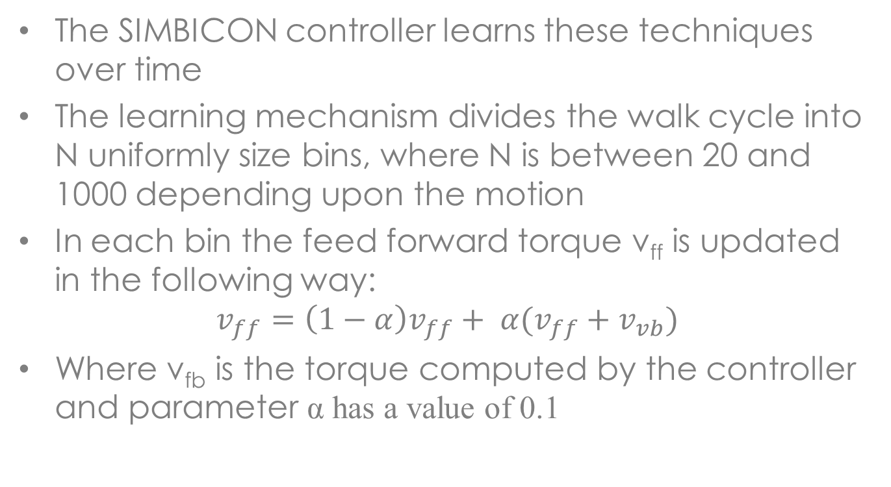
SIMBICON
The SIMBICON controller learns these techniques over time
The learning mechanism divides the walk cycle into N uniformly size bins, where N is between 20 and 1000 depending upon the motion
In each bin the feed forward torque v_{ff} is updated in the following way:
$$v_{ff}=\left(1−α\right)v_{ff}+ α(v_{ff}+v_{vb})$$
Where v_{fb} is the torque computed by the controller and parameter α has a value of 0.1

Slide 17
SIMBICON
The following slide shows some examples of the motion produced by SIMBICON
The source code for SIMBICON is on the course website

Slide 18
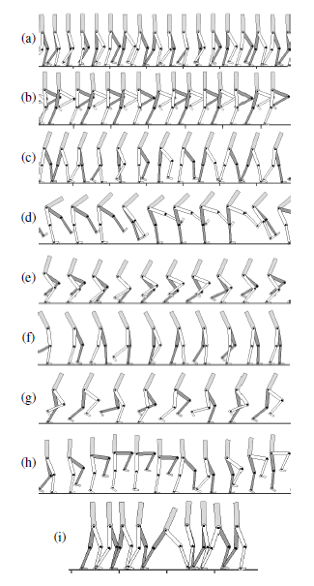
SIMBICON

Slide 19
Task Based Motion
SIMBICON gives us a set of basic motions, but most characters don’t walk forever in the same direction
We need to put the basic motions together to get goal directed behavior
We need to put together a sequence of controllers that produce interesting motion
In the next work the SIMBICON controller are used as the basic motion vocabulary to produce task based motion
Example tasks are shown on the next slide

Slide 20
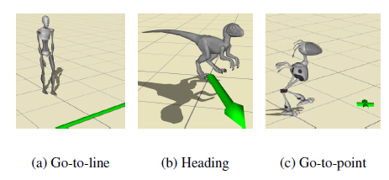
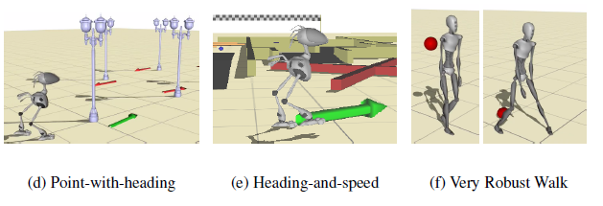
Task Based Motion

Slide 21
Task Based Motion
We want to construct a function π that given the current state of the character and goal determines the next action to perform, where the action is one of our motion controllers
The current state s of the character consists of its position, orientation, velocity, angular velocity, angle for each joint along with its angular acceleration
The current state w of the task represents the goal we are trying to achieve, for example the relative position and orientation of the goal with respect to the character

Slide 22
Task Based Motion
The current state of the problem is the combination of the character and task states, g = (s,w)
At each step in the motion we want we select the action a given by a = π(g), we now turn our attention to constructing this function
First we need to know the impact of a on the current state s, that is executing a will produce a new state s’
We can represent this information by a dynamics tuple D = (s,a,s’), exploring the space of these tuples will give us the raw material required to piece together the states to reach our goal

Slide 23
Task Based Motion
But, there is a problem here, s is multidimensional and each dimension is continuous, so we have an infinite number of states
We need to reduce this to a finite number of states
This can be done by starting with a small number of trusted states, these are states that make sense from a controller transition perspective
Typically this set is relatively small, usually drawn from the states of the motion controllers, plus some interesting transition states
Both s and s’ should be in the set of trusted states, which reduces the search space considerably

Slide 24
Task Based Motion
The algorithm for exploring the dynamics tuple space is shown on the next slide
Since our states are continuous we won’t directly hit a trusted state, if we are within a given radius of a trusted state we are considered to be in a trusted state, this is given by:
d(s’,s)<ε_{T} for some s in the set of trusted states
The function d() measures the distance between states and is a weighted sum of the differences in velocities, differences of angular velocities and the differences in angles between the states

Slide 25
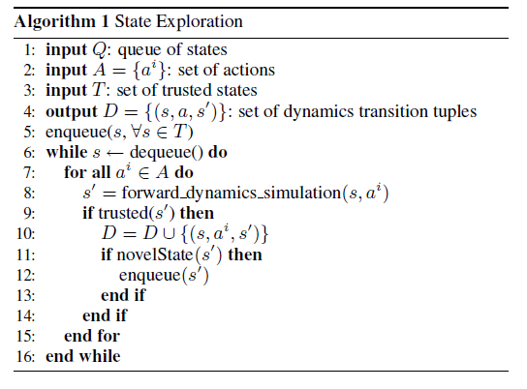
Task Based Motion

Slide 26
Task Based Motion
Similarly the s’ are continuous, so s’ must be a certain distance from all existing states to be considered a new state, that is
d(s’,s)>ε_{N} for all states in D
These two conditions are represented by the functions trusted() and novelState() in the algorithm
Similarly we can produce a discrete number of task states, so we can augment our dynamics tuples with the task states before and after the action a is performed to give (s,w,a,s’,w’)

Slide 27
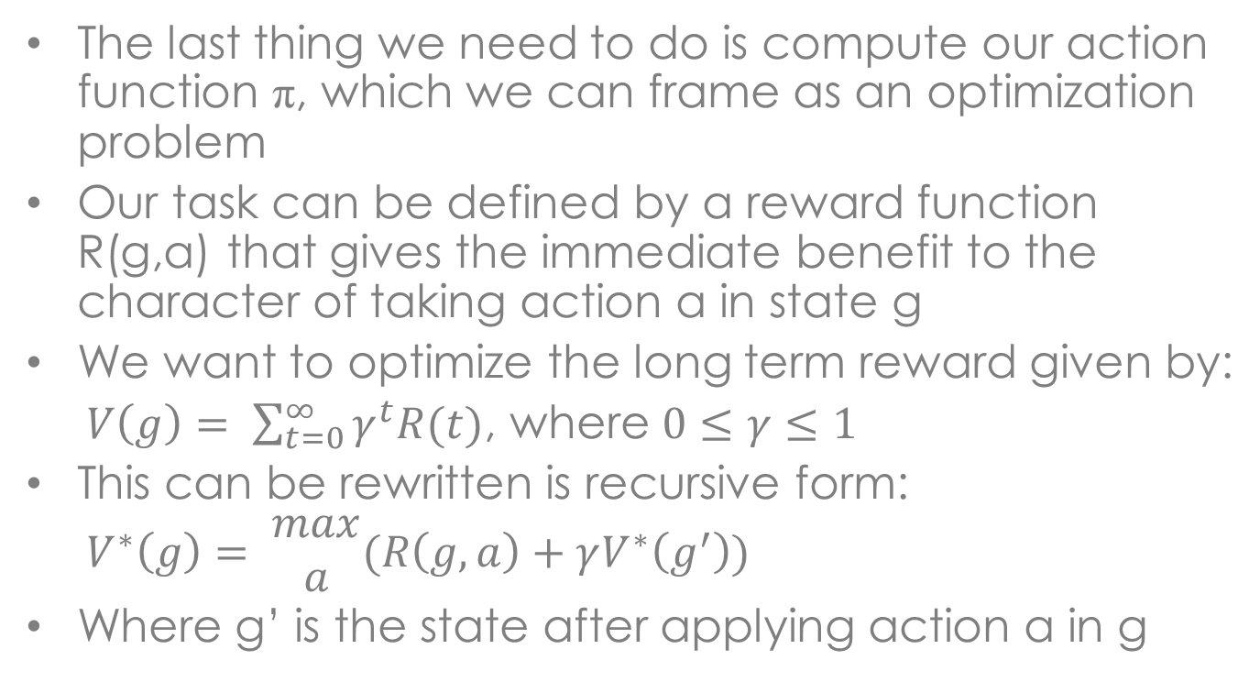
Task Based Motion
The last thing we need to do is compute our action function π, which we can frame as an optimization problem
Our task can be defined by a reward function R(g,a) that gives the immediate benefit to the character of taking action a in state g
We want to optimize the long term reward given by:
$V\left(g\right)= \sum_{t=0}^{∞}{γ^{t}R(t)}$, where $0≤γ≤1$
This can be rewritten is recursive form:
$$V^{∗}\left(g\right)= \begin{matrix}max \\ a\end{matrix}(R\left(g,a\right)+γV^{∗}\left(g^{′}\right))$$
Where g’ is the state after applying action a in g

Slide 28
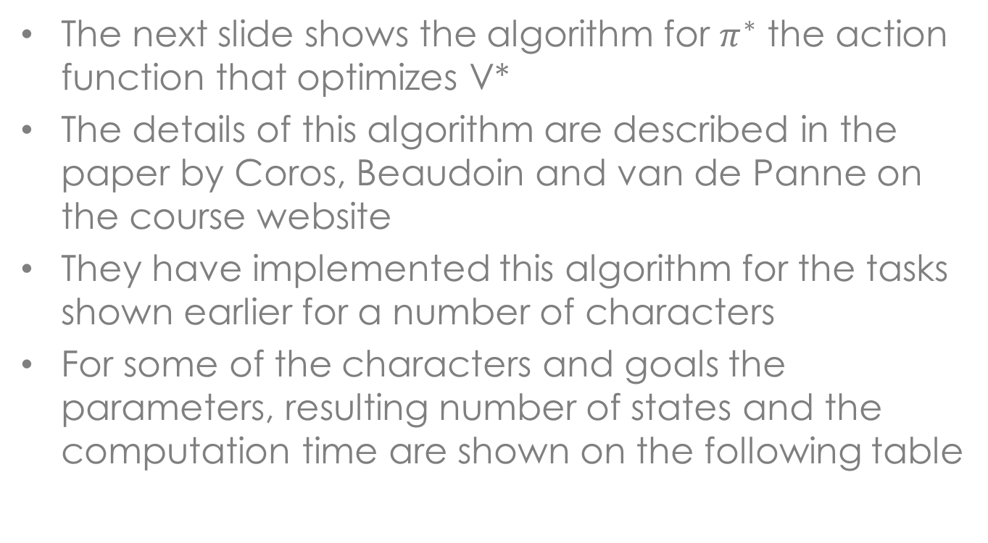
Task Based Motion
The next slide shows the algorithm for $π^{∗}$ the action function that optimizes V*
The details of this algorithm are described in the paper by Coros, Beaudoin and van de Panne on the course website
They have implemented this algorithm for the tasks shown earlier for a number of characters
For some of the characters and goals the parameters, resulting number of states and the computation time are shown on the following table

Slide 29
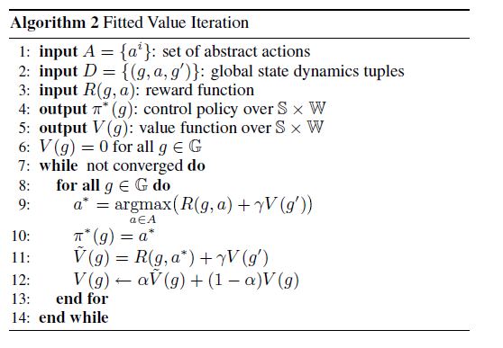
Task Based Motion

Slide 30
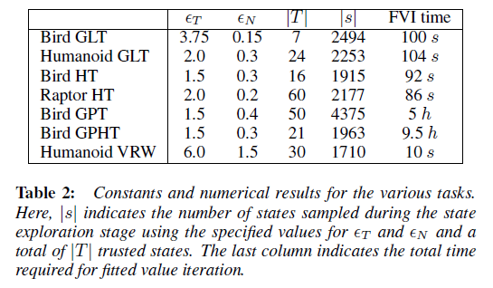
Task Based Motion

Slide 31
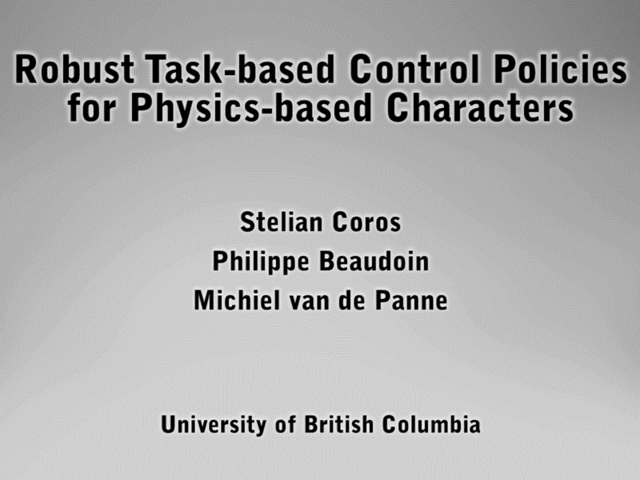
Video

Slide 32
Task Based Motion
The authors have also produces a simple game based on this technique, this game is one the website so you can give it a try

Slide 33
Crowds
Boids for people
Important for both simulation and animation, similar techniques used in both areas
For simulation want to know the paths crowds will take through a structure, plan layout of buildings and attractions
Disney interested for attraction design, get as many people through as possible, avoid bottlenecks, increase revenue
Design buildings for efficient evacuation in the case of disasters

Slide 34
Crowds
Want to have realistic motion, emergent behaviors, without using vast amount of computing time
Interactive crowd simulations challenging due to the large number of characters, cannot have sophisticated behavior for each character
Many different techniques have been used, we will look at three:
Agent based
Data driven
Fluid dynamics

Slide 35
Agent Based
View each individual in the crowd as an agent, computes its own motion based on its agenda, goals and needs
Each agent senses the environment and bases its actions on what it sees
Social agents will form groups, other individuals in the group will influence their decisions
Needs to have variety, all the agents can’t be doing the same thing at the same time, must react differently

Slide 36
Agent Based
Nuria Pelechano in Crowds: Methods, Simulation and Control identifies 4 main types of actions:
Scheduled actions: planned deliberate behaviors, I need to go to the bank
Reactive actions: triggered by contextual events or environment, avoiding collisions
Opportunistic actions: not scheduled reaction to context, but meets goals or priorities of the agent, hungry and near a source of food -> eat
Aleatoric actions: random, but structured by agents motives, context, etc., the default action when there is nothing else to do

Slide 37
Agent Based
Decisions can be based on a combination of motivation and opportunity
Motivated to go shopping, but not near stores, so shopping doesn’t occur
Near stores, but not motivated to go shopping, again shopping doesn’t occur
Need some way of representing these decision in an agent
One common approach is to use rules similar to boids, could also try decision trees or maybe even finite state machines

Slide 38
Agent Based
Different agents may have different rule sets or they may be parameterized differently, want variety in behavior
Example: group formation
Each group has a leader, controls direction or goal of the group
Leader may change over time
The remainder of the group are followers, they try to follow the leader

Slide 39
Agent Based
Leader rules:
Determines goal or destination, independently from the group
If group member is “far” leader slows down and waits for him
If group member is “too far” leader will go get them
Follower rules:
Want to walk beside leader
Head where leader is heading
If leader “far” in front, walks faster
If leader “far” in back, walks slower
If leader stops, get closer to leader and stop

Slide 40
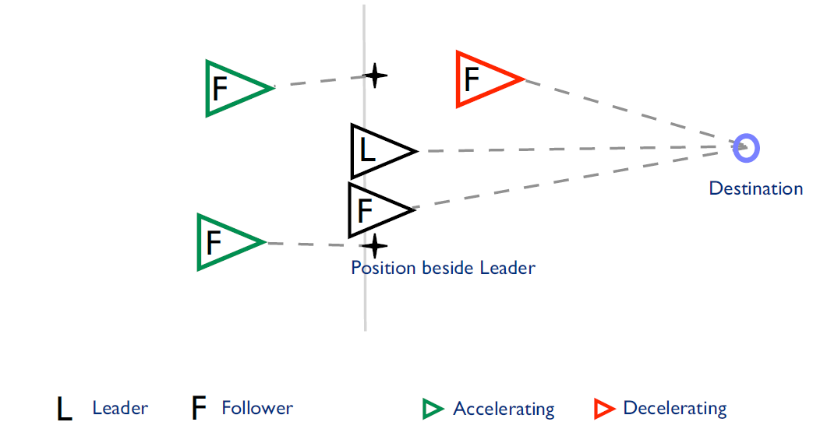
Agent Based

Slide 41
Agent Based
Another example is queues, how people and groups line up
The head of the queue is a service, the person at the front is receiving the service, when they are finished the next person moves up to the service
Short queues (< 5 people) are usually straight, longer queues are the more interesting ones, they show more interesting behavior
Each person has a comfort or waiting distance, the distance to the next person in the queue, they will move forward when the next person exceeds this distance

Slide 42
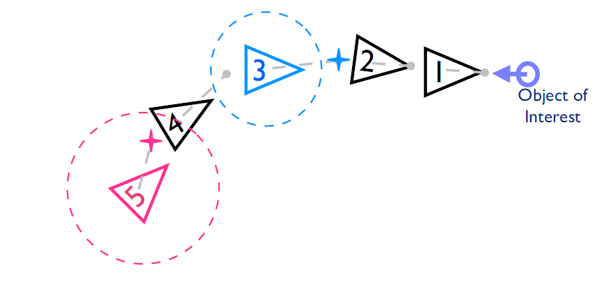
Agent Based

Slide 43
Agent Based
In this case agent 3 will move forward, but agent 5 will wait
This produces a wave through the queue, something we see in real queues and at stop lights
Queues form at the end, the direction of the queue is based on the last few members, the agent that is closest to the end in this direction is the one that joins
In the next slide agent B’s position projected onto the queue orientation is the closest, so they are next to joint the queue, followed by P1 and P2

Slide 44
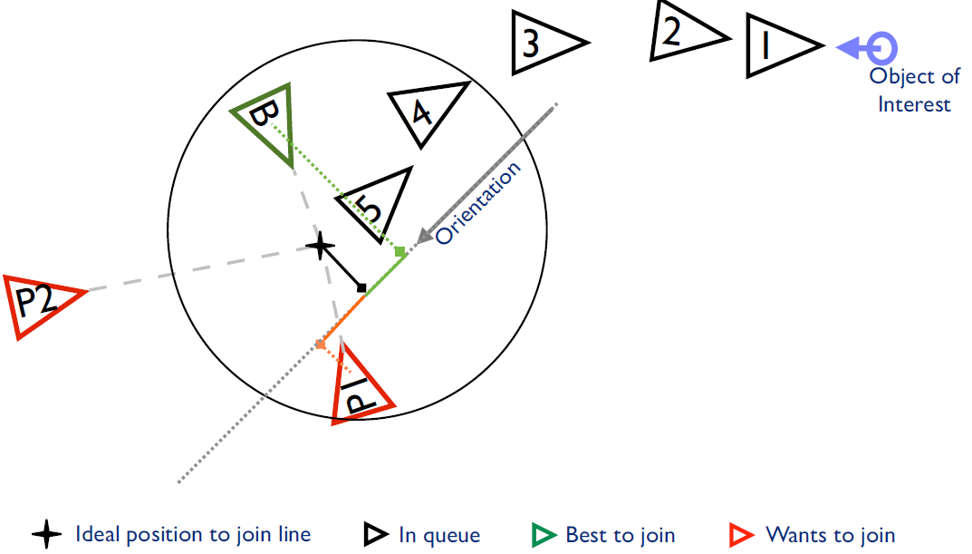
Agent Based

Slide 45
Agent Based
This becomes slightly more complicated when groups are involved
The end of the queue becomes fuzzy as the group is spread out as it joins
Eventually the group member will join the leader at his or her position in the queue
This approach has been used by Disney to evaluate their theme parks, has resulted in the redesign of some attractions and services

Slide 46
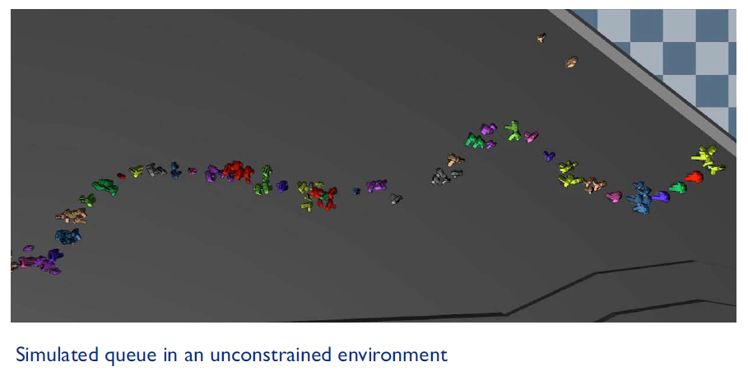
Agent Based

Slide 47
Data Driven
Motion capture for crowds
For smaller environment can capture the motion of individuals in a crowd, extract decision process, use data to drive decisions in crowd animation
Jehee Lee’s group at Seoul National University have worked on this approach
Their motion capture system is shown in the next slide
Camera is placed about the crowd looking down to capture the motion of the individuals

Slide 48
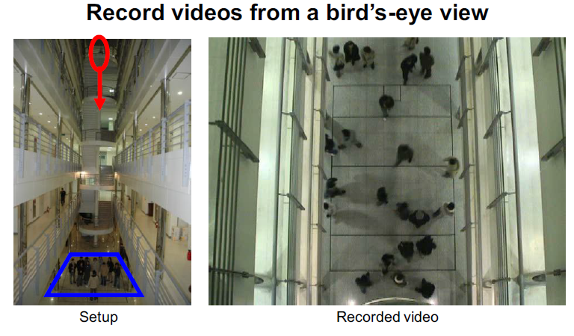
Data Driven

Slide 49
Data Driven
Could try to replay the motion similar to what is done with motion capture, but this doesn’t introduce anything new into the simulation
Want to extract the decision making process from examples
Build a table consisting of states and actions
At each step in the animation the agent is in a particular state, lookup this state in the table and perform the corresponding action
The state is an n-dimensional feature vector, the action is a 2D vector, the displacement of the agent

Slide 50
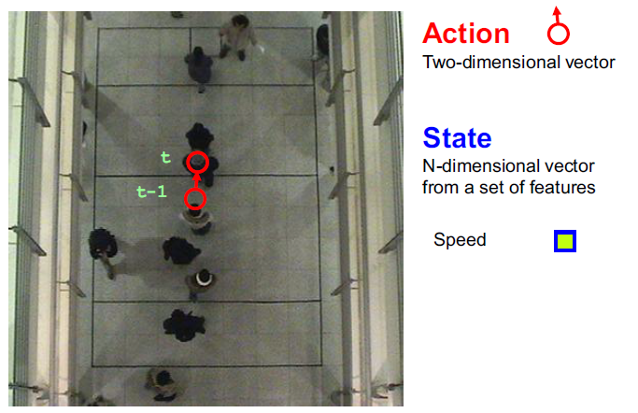
Data Driven

Slide 51
Data Driven
If we just consider the current speed, the motion will be straight forward
This is a basic behavior, but not very realistic
Must also consider the possibility of a collision
Sample the directions around the agent looking for potential collisions
Do a discrete sampling so we can include it in our feature vector

Slide 52
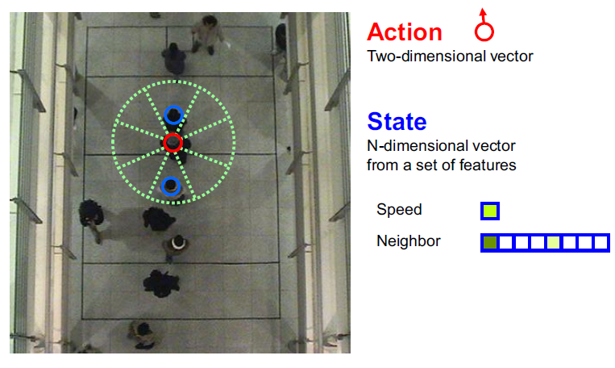
Data Driven

Slide 53
Data Driven
Also need to consider where the agent is heading
We don’t know their goal, but we can track their motion over time to see where they end up
This is the closest we can get to goal based behavior given captured data
End up with a 21-dimensional state vector
Analyzing video can fill in the table, may not be complete, so there may be a need to interpolate or find the closest state
Quality depends on length of sample and variety of motions

Slide 54
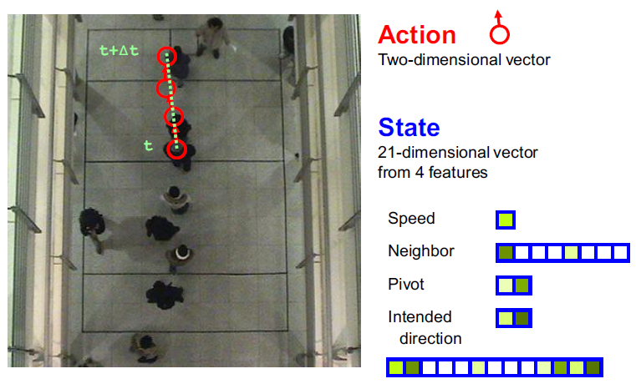
Data Driven

Slide 55
Data Driven
Show group behavior video with Quicktime
This replicates what real people do, it will produce a realistic simulation or animation
Will not produce behaviors that aren’t in the original video sequence
Cannot predict reaction to an event that doesn’t occur in the captured data
Example: cannot use to simulate an emergency evacuation

Slide 56
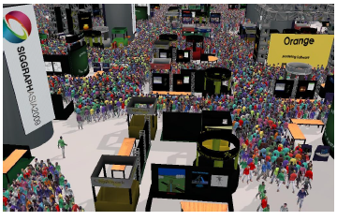
Fluid Dynamics

Slide 57
Fluid Dynamics
There is a problem with very large crowds
There are many agents, simulating each one becomes expensive
As the density of the crowd increases the motion of each agent is restricted
They must go with the flow and cannot move in any direction they please
With high density crowd behaves like a fluid, but for lower densities it is more like individuals

Slide 58
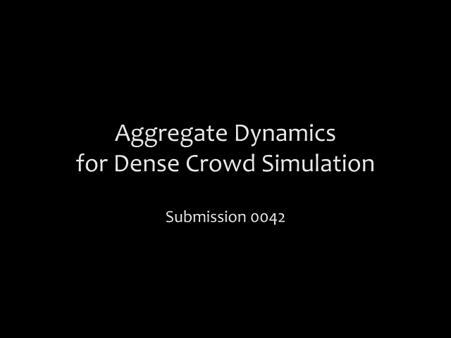
Video

Slide 59
Fluid Dynamics
The technique developed by Lin’s group at UNC is based on fluid dynamics
It is based on using a global path finding algorithm for each agent to determine its ideal velocity
Path finding doesn’t consider the other agents, only the static obstacles and the agent’s goal
The positions and velocities of each agent are then converted to a grid that will be used for fluid dynamics
Given the size of the grid and the number of agents in it a density can be computed

Slide 60
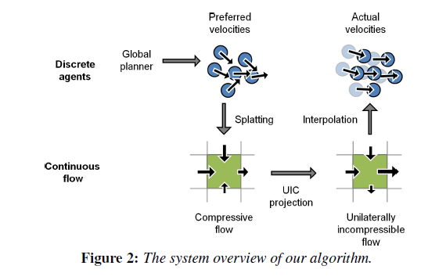
Fluid Dynamics

Slide 61
Fluid Dynamics
If this density is below a threshold the agents continue their individual behavior
Otherwise they are treated as a fluid and the motion of the crowd is computed on an aggregate basis
For each cell there is a velocity field (x and y) and a density
There is a maximum density that limits the packing of people in the crowd, determined by the minimum distance between agents

Slide 62
Fluid Dynamics
Once the maximum density is reached a pressure exits in the crowd that can be used to drive the fluid dynamics simulation
Basically, the velocity in the cell will be modified to reduce the pressure to zero in the next time step
Once this velocity has been computed the velocities of the individual agents are modified to go along with the flow
These velocities are further modified to avoid immediate collisions with neighbours

Slide 63
Fluid Dynamics
We won’t go into the detailed mathematics, which you can read in the paper on the website
This produces good crowd motion in areas of high density with a reasonable amount of computation
It runs in real-time or close to real-time for large crowds

Slide 64
Summary
Have examined robust controllers for locomotion
Extended this to more goal based behaviors
Examined different approaches to crowd modeling
This work represents the state of the art in research in both of these areas

